Slide 1



Synthetic File System

Slide 2
GOAL
Develop a new file system as a Linux FUSE module that provides a unified view on a pre-configured set of existing file systems.
01
Provide the capability to browse using an existing Linux file system browser.
02
Provide read and write support within the new mount points.
03

Slide 3
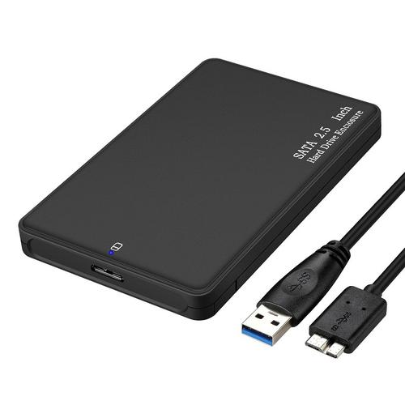
Filesystems
Dumb storage device
Store information
Provide hierarchical abstraction
NTFS
FAT
EXT
exFAT
HFS Plus

Slide 4
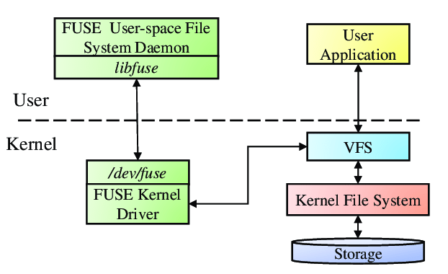
FUSE – Filesystem in USErspace
Writing personal filesystem kernels is troublesome and tedious.
With FUSE, it is possible to make kernel calls to perform filesystem operations and redirect them back into a user program for handling.

Slide 5
DEMO

Slide 6
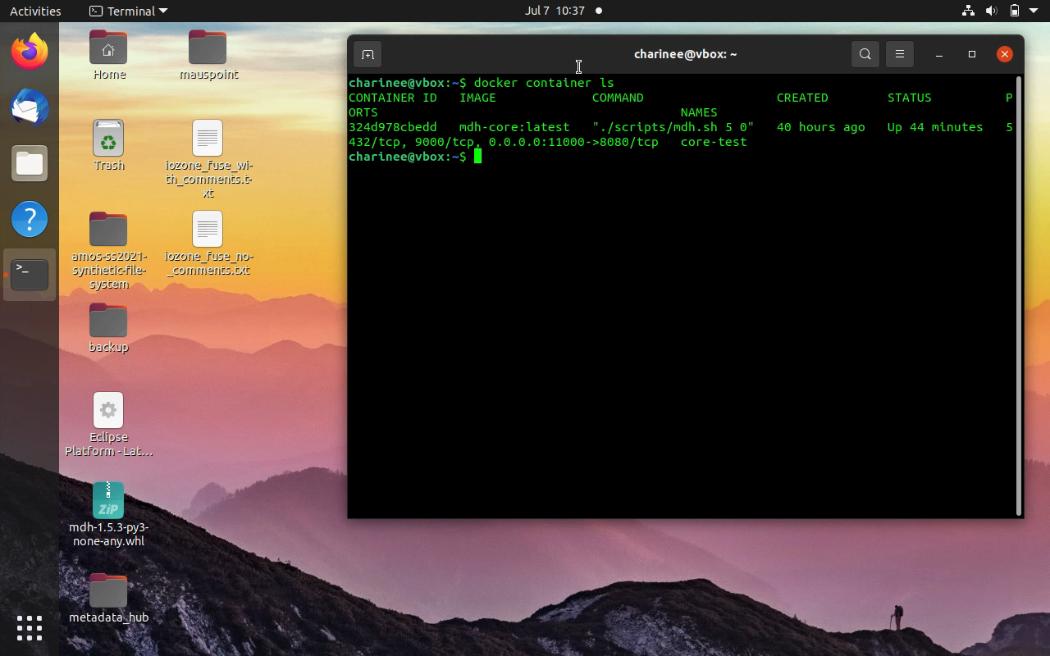

Slide 7
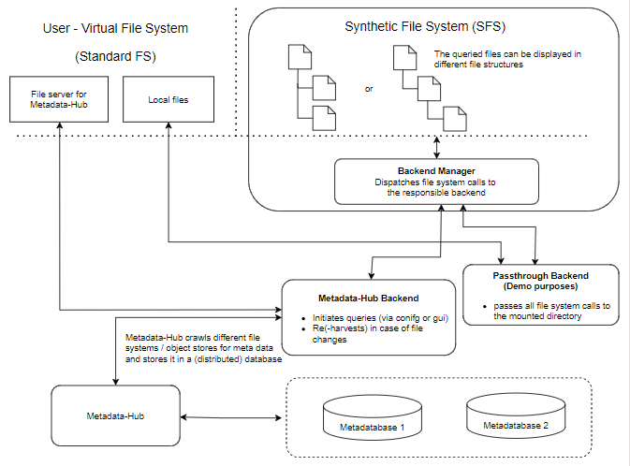
The SFS Architecture

Slide 8

THANK YOU!

